Slide 1
Click Through RatE (CTR) Prediction
Vanraj Dinesh Bohra
Email : vanrajbohra@gmail.com
August 2022

Slide 2
Agenda
Business Problem Statement
EDA
Model Building
Feature Engineering
Model improvement
Gradient Boosting Classifier
AdaBoost Classifier
Logistic Regression
Model Evaluation

Slide 3
Business Problem Statement
Problem Statement:
CTR is an important exercise companies need to do before making any decision on Online Advertising.
CTR is a very important metric for evaluating ad performance.
The objective is to predict whether the audience will click on an ad or not and thus help the marketing team answer ad placement-related questions.
Analysis Objective:
Perform EDA on the dataset provided.
Implement and evaluate different Classification model and assess model performance.
Use model simplification techniques like feature creation and selection, to improve model predictability.
Data to Analyze:
99999 record with classifier where user have clicked on add or not.
25 other attribute such as site detail, app detail, device detail and 8 other anonymous attribute is available in data to analyse

Slide 4
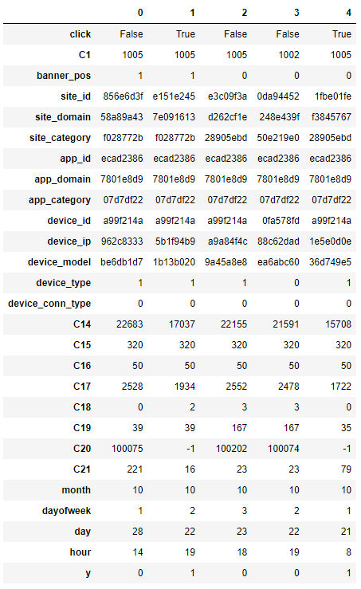
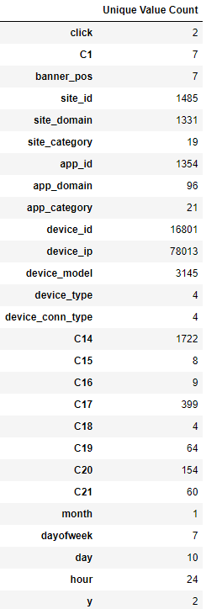
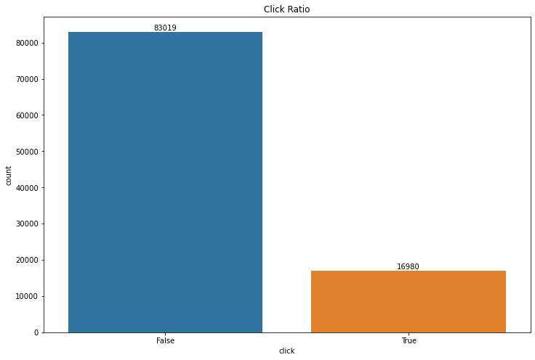
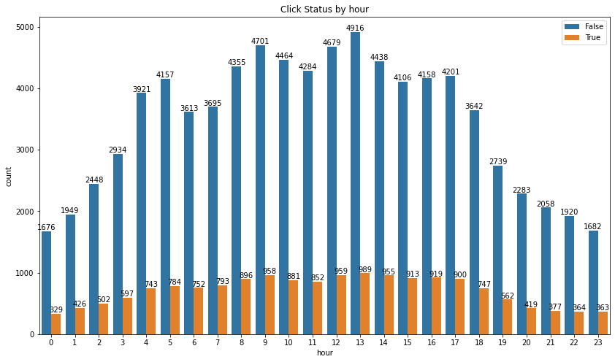
EDA
Data Cleansing:
Checked Duplicate column if available in given dataset
Null handling
Univariate and Bivariate Analysis*:
3. Dropping redundant / irrelevant column:
Dropped month, device_id,device_ip site_id, app_id in order to keep data simple and we were having another supplementary feature available in dataset for this
4. Train Test Split :
Data is split into 70-30 split as a train and test dataset.
*Univariate and Bivariate Analysis is done for all the variables, Please refer python notebook for more detail

Slide 5
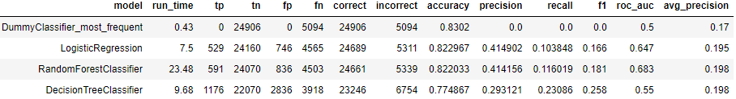
Model Building
One Hot Encoding / Dummy Encoding :
Dummy encoding on dataset resulted in 22 column converted into 7075 column
A dummy variable is a binary variable that indicates whether a separate categorical variable takes on a specific value.
For example, if a banner_pos have 7 unique value, then 7 different column will be created with value 1 and 0.
Train-Test Data Split: Data is split into Train and Test in 70-30 ratio.
Scaling: Standardized the train and test data by scaling.
Model Build: Model is built, and result is for following algorithm:
Result :
Accuracy and ROC_AUC doesn’t seem to be great for classification model
Dummy encoding of feature columns leads to high cardinality.
It doesn't make sense to model with such complex number of columns due to poor interpretability and high computational time.¶
So, its better to encode columns based on statistics as it will result in fewer columns and will be interpretable.

Slide 6
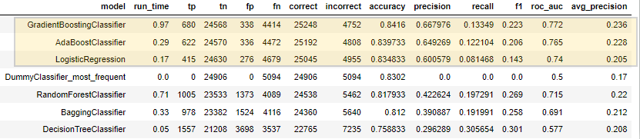
Feature Engineeeing:
Feature Engineering done by creating ratio of Clicked vs Non-Clicked and Quantiles:
Impression are total click per category
CTR is the ratio of Clicked over total impression.
Non Click ratio is Non-Clicked over total impression.
we find odd ratio such as CTR / Non-Click Ration
Quantile category 3 has above 75% of the CTR values
Quantile category 2 has above 50% of the CTR values
Quantile category 1 has above 25% of the CTR values
Quantile category 0 has less than 25% of the CTR values
We ran Machine Learning model on this prepared data
Result shows Gradient Boosting Classifier, AdaBoost Classifier and Logistic Regression clearly outperformed:

Slide 7
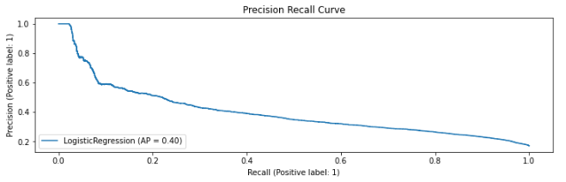
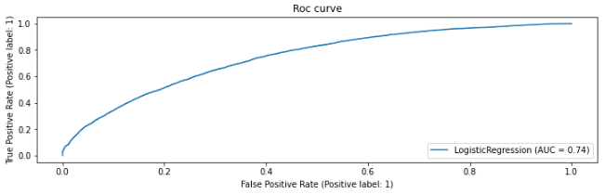
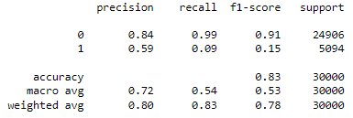
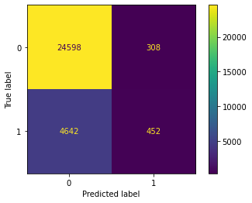
Model Improvement : Logistic Regression(Hyperparameter Tuning)
Logistic Regression:
It is valuable for predicting the likelihood of an event
Since there are two classes of the dependent variable(click feature), logistic regression help in determining their probabilities.
It's mainly used when the prediction is categorical, for example, yes or no, true or false, 0 or 1.
Hyperparameter Tunning :
Inverse of regularization strength(C) set to 100
Penalty is set to 12
Above value we got from Grid Search SV (cross-validated grid-search)

Slide 8
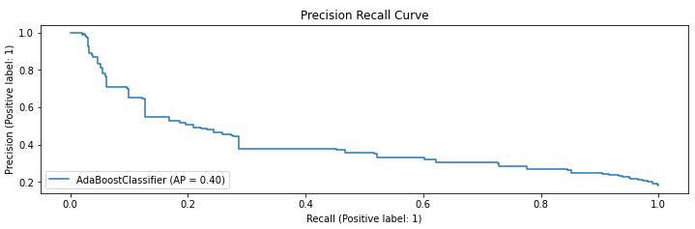
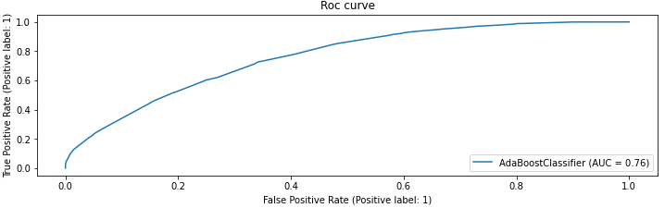
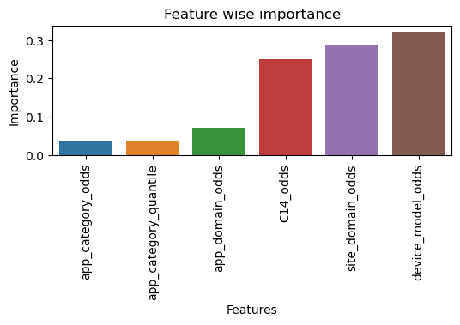
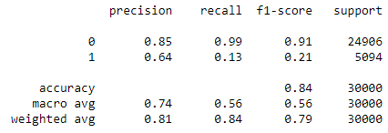
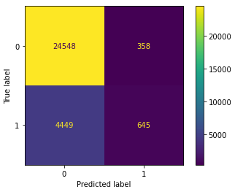
Model Improvement : AdaBoost Classifier(Hyperparameter Tuning)
AdaBoost Classifier:
AdaBoost is best used to boost the performance of decision trees on binary classification problems.
Hyperparameter Tunning:
n_estimator = 28
The maximum number of estimators at which boosting is terminated.
learning_rate = 1
Above value we got from Grid Search SV (cross-validated grid-search)
Accuracy percentage slightly only increase after hyper parameter Tunning
Based on Feature Coefficient, we can select important feature as device model(odd), site domain(odd), C14(odd), app domain(odd) and app category(odd)

Slide 9
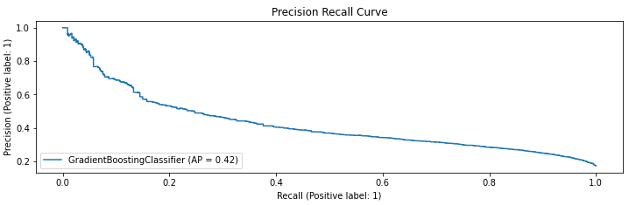
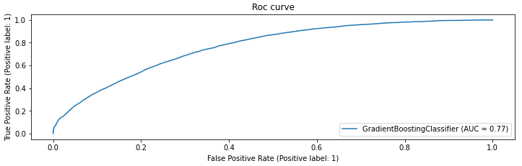
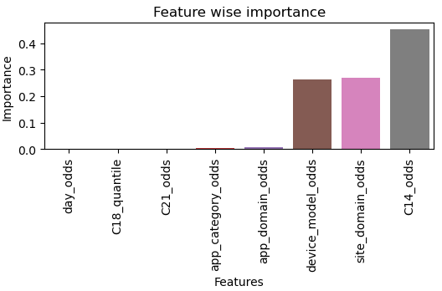
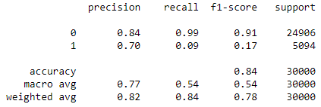
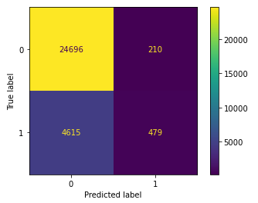
Model Improvement : Gradient Boost Classifier(Hyperparameter Tuning)
Gradient Boost Classifier:
AdaBoost is best used to boost the performance of decision trees on binary classification problems.
Iteratively learns from each of the weak learners to build a strong model.
Lots of flexibility - can optimize on different loss functions and provides several hyper parameter tuning options that make the function fit very flexible.
Hyperparameter Tunning :
n_estimator = 28
The maximum number of estimators at which boosting is terminated.
learning_rate = 1
Above value we got from Grid Search SV (cross-validated grid-search)
Above value we got from Grid Search SV (cross-validated grid-search)
Based on feature coefficient, we can select the important features with positive coefficient - c14, site_domain, device_model

Slide 10
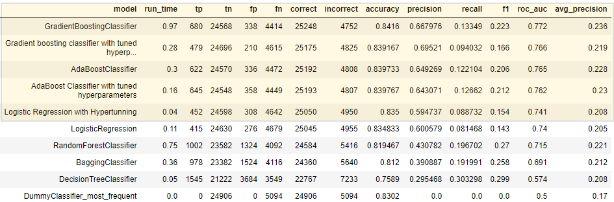
Model Evaluation:
we are selecting Gradient Boost Classifier algorithm for following reason:
Gives highest ROC-Accuracy score(Area under curve of ROC curve works as a good measure of model performance).
Good Accuracy Score : 84.16%.
Best Correct prediction : 25248 correct
Average Precision score is also best

